Slide 1
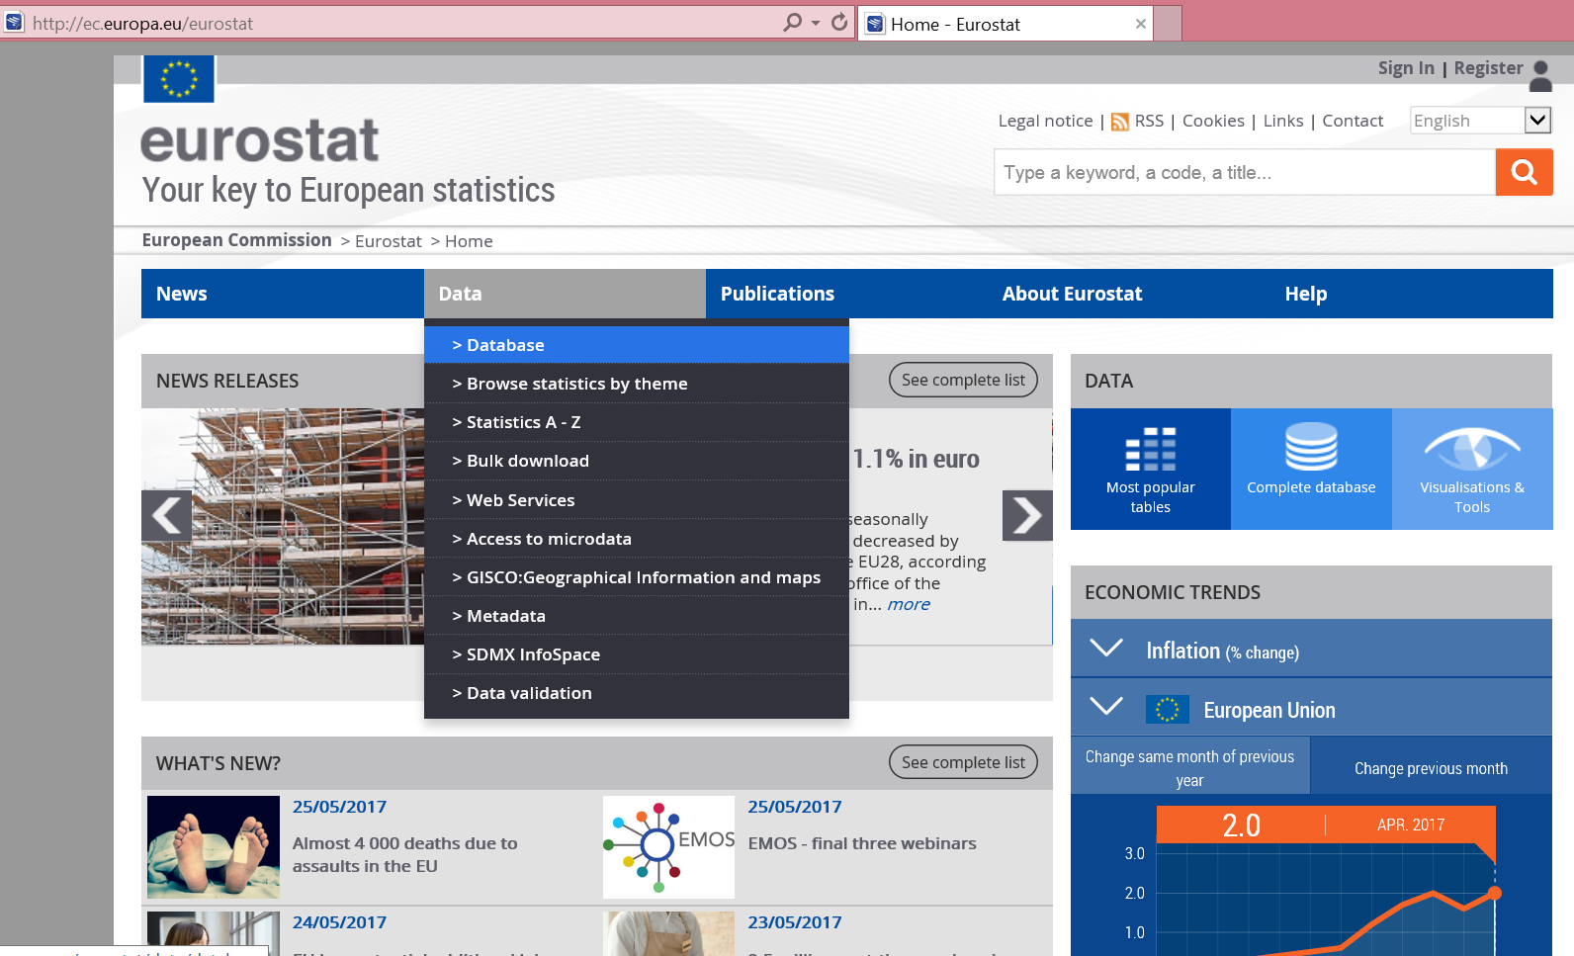
Procedure to obtain PPI data for European Countries
  1. Go to:
  2. Move cursor to “Data” and then from the dropdown menu click on “Database”.
  ec.europa.eu/eurostat

Slide 2
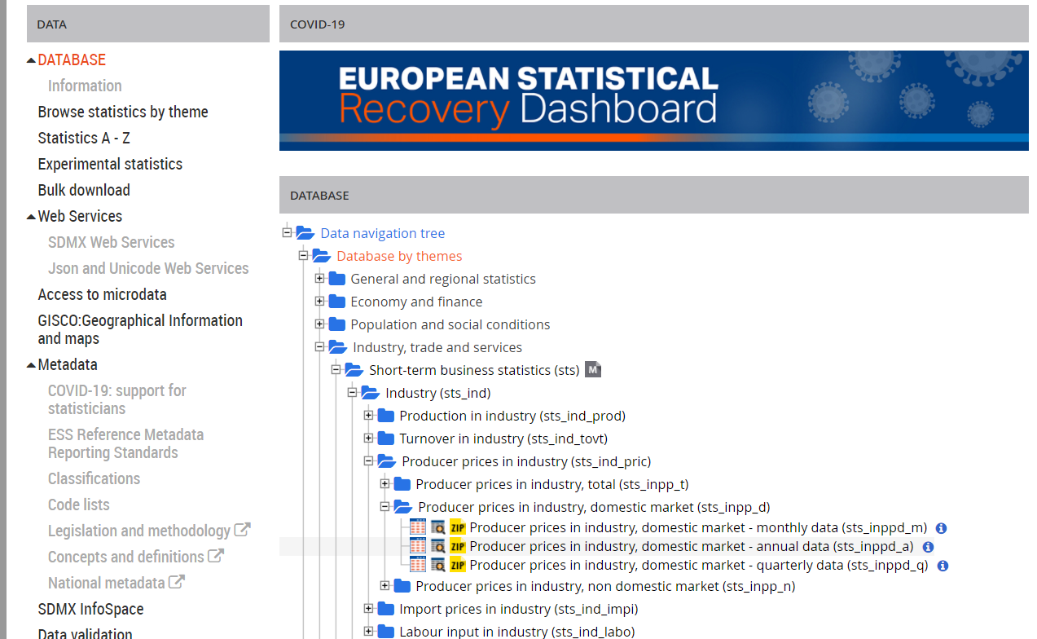
Procedure to obtain PPI data for European Countries
  Under database, select “Database by Themes”
  From the drop-down menu, click on “Industry, Trade and Services”
  Click on “Short Term Business Statistics”
  From the next drop-down menu, click on “Industry (sts_ind)”
  From the next drop-down menu, click on ”Producer prices in industry (sts_ind_pric)
  Click on “Producer prices in industry, domestic markets (sts_inpp_d)
  Clicl on “Data Browser” icon next to Annual Data (sts_inppd_a)

Slide 3
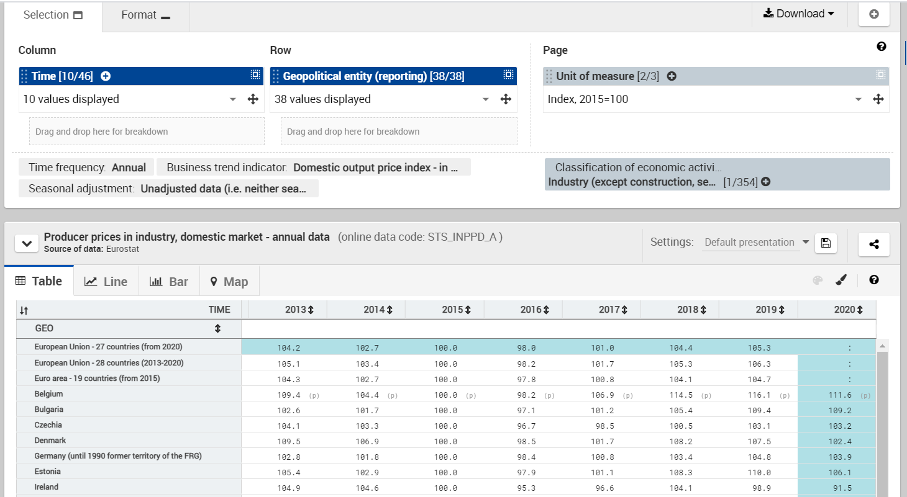
Procedure to obtain PPI data for European Countries
  The Producer Price Index is presented in a table
  You can select a specific industry by clicking on the “+” sign, under Classification of Economic Activities

Slide 4
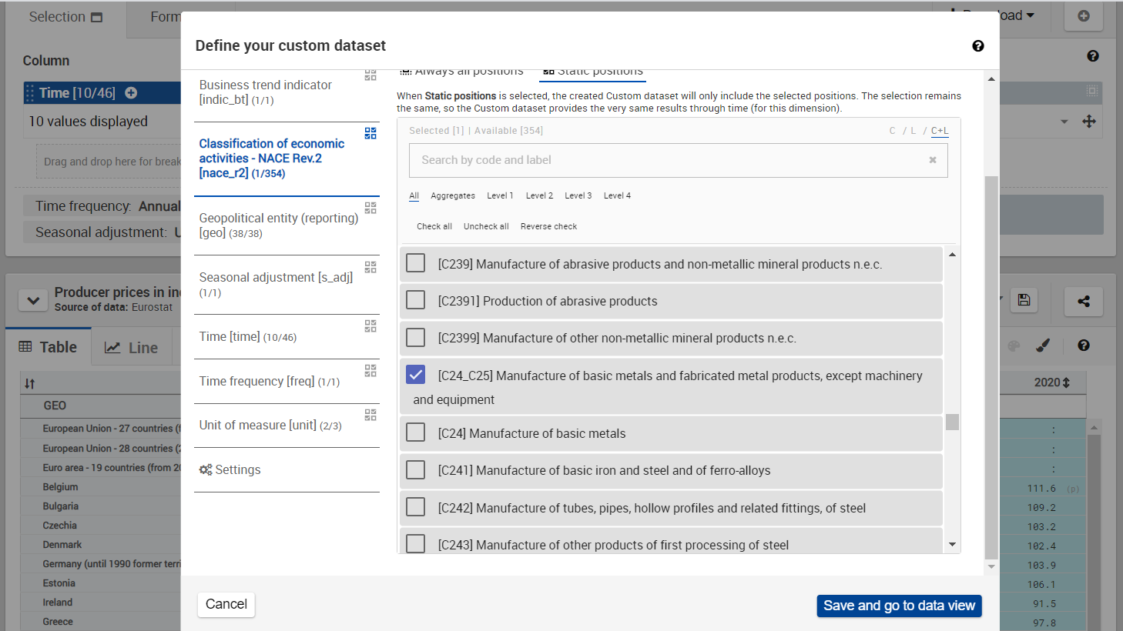
Procedure to obtain PPI data for European Countries
  To choose an industry, make appropriate selections in the pop-up window
  Click on “Save and go to data view”

Slide 5
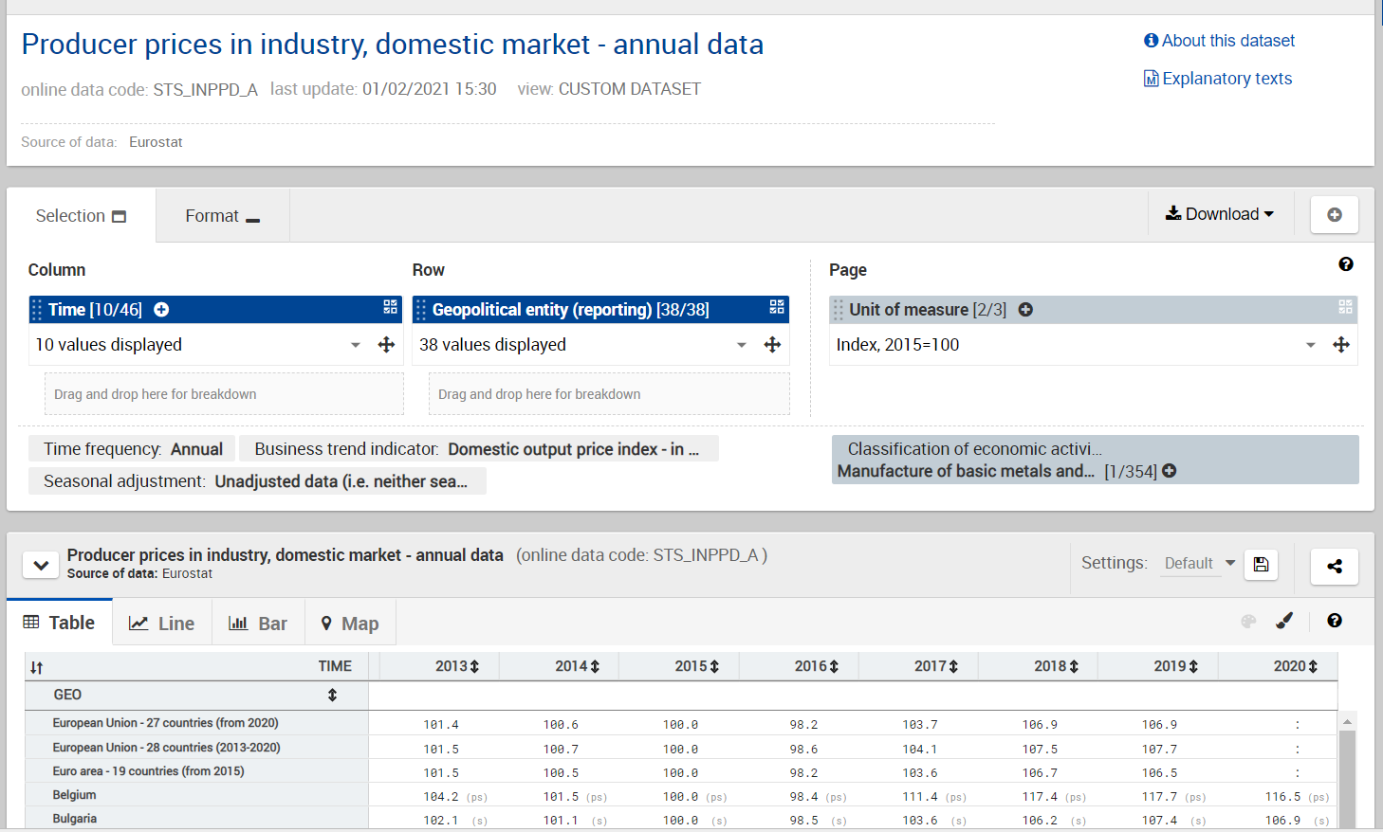
Procedure to obtain PPI data for European Countries
  To customize the data table (for example to select only one country, or change the time period) click on appropriate filters above
  To download the data in Excel click on the “Download” tab

